Slide 1
Programming Fundamentals in C++
(Practical#07)

Slide 2
Objective: To become familiar with Functions in C++
A function is a subprogram or part of a program that is called many times throughout the main program.
A function groups a number of program statements into a unit and gives it a name. This unit can then be called/invoked from other parts of the program.
A function is a piece of code that is called by name. It can be passed to operate on (i.e. the parameters) and optionally return data (the return type)
In other languages, the same concept may be referred to as method or subroutine.

Slide 3
Inside a function you define some functionality and give it a name, that functionality can be
Simply display a message on the monitor’s screen, or
calculating the sum or product of two numbers.
Now you can call that functionality by it’s name anywhere in the program.

Slide 4
Every C++ program has at least one function, which is main().

Slide 5
Types of Functions
There are two types of functions

Slide 6
Pre-Defined Functions
Also called as built-in functions.
The functions which are already built inside the C++ standard library, are called as pre-defined functions.
You do not need to create them, just call them whenever you want to use them.
Example :
getch(), getche(), getline(),

Slide 7
Few of the examples of pre-defined functions are:

Slide 8
User-Defined Functions
Also called as Programmer-Defined functions.
The programmers define the functionality of the
functions by themselves.

Slide 9
Creating User-Defined Functions in C++
In order to create a user-defined function in C++ you need to provide:
Three main components of a function
Function Declaration
Function Definition
Function Calling

Slide 10
Creating User-Defined Functions in C++
Function Declaration : are also called Function prototype.
Specifies the function name, arguments/parameter types and return Type.
The function declaration is terminated by a semicolon
Function declaration Name
Parameter List
Return Type void display( );
Return Type void showdata ( string, string );

Slide 11
The Function Definition
The function itself, which is referred to as the function definition.
The definition contains the actual code for the function.
Contains line of code that constitute the function

Slide 12
The Function Definition
The definition consists of a line called the declarator (first line of function definition), followed by the function body.
The function body is composed of the statements that make up the function , delimited by braces.

Slide 13
The Function Definition
Examples: Name
Return Type void display ( )
{
Function Body cout<<“C++ Programming”;
}
void showdata (string firstName, string lastName )
{
string str= firstName + ” ” + lastName;
cout<<str;
}

Slide 14
Calling the Function
Causes the function to be executed.
The function is called(or invoked, or executed) by specifying the function name & argument list enclosed in parenthesis if required.
Call is terminated by a semicolon.

Slide 15
Calling the Function
Causes the function to be executed.
Executing the call statement causes the function to execute; that is, control is transferred to the function , and then control returns to the statement following the function call.

Slide 16
Calling the Function
Examples
Function Name display();

Slide 17
Eliminating the Declaration
There are two ways to define/ use functions in a program. First approach is to declare the function before it is called.
The second approach is to eliminate the function declaration and place the function definition before the first call to the function.

Slide 18
Advantages :
The most important reason to use functions is to aid in the conceptual organization of a program.
functions reduce program size.
Functions make the program more comprehensible.
The function’s code is stored in only one place in memory, even though the function is executed many times in the course of the program.
functions save memory space b/c all calls to the function cause the same code to be executed.

Slide 19
Passing arguments to functions
An argument is a piece of data passed from a program to the function.
OR an argument is an input to a function.
OR arguments are the values that are passed from the calling program/code to the function.

Slide 20
Arguments
Arguments :
An argument is an input to the function,
Values passed from the calling program to the function are called
arguments.
Example sum(5, 10); Function call

Slide 21
Passing arguments to functions
Declaring a function with a Parameter
Name Parameter List
Return Type void sum(int, int);

Slide 22
Arguments and Parameters
Arguments :
An argument is an input to the function,
Values passed form the calling program to the function are called
arguments.
Example sum(5, 10); Function call
Parameters: The variables used within the function to load the argument values are called Parameters.
Example
showdata(string firstName, string lastName) Function definition
{ //code goes here }

Slide 23
Returning values from functions
return statement: Transfers the return value to the calling code/program.
When a function completes its execution, it can return a value to the calling program.
When a function returns a value we specify the return type in the definition
return keyword to end the function execution.

Slide 24
Passing arguments to functions
In a function the arguments can be passed “By Value” or “By Reference”.

Slide 25
Passing Arguments to a Function By Value
When arguments are passed by value, the called function creates new variables of the same type as the arguments and copies the argument’s values into.
In pass by value, the actual variables are not affected.
In pass by value the function creates copies of the arguments passed to it.
By default, C++ uses call by value to pass arguments.

Slide 26
Passing Arguments to a Function By Reference
A reference provides an Alias i.e. a different name for the variable .
In pass by reference a reference to the original variable in the calling program is passed.
Actually the memory address of the variable that is passed.
In pass by reference the function can access the original variable in the calling program.

Slide 27
Overloaded Functions
Multiple Functions with same name but having different number of arguments.
Examples void display ( )
{ cout<<“C++ Programming”; }
void display (string firstName)
{ string str= firstName; cout<<str; }
void display (string Rollno, string distt)
{ // code }

Slide 28
Returning by Reference
Besides passing by reference, you can also return a value by reference
//returning by reference
void modifyStr(string &str)
{ str = str + " World!"; }
int main()
{ string greeting = "Hello";
modifyStr(greeting);
cout << greeting;
return 0;
}

Slide 29
C++ Recursion
When function is called within the same function, it is known as recursion in C++.
The function which calls the same function, is known as recursive function.
A function that calls itself is known as a recursive function. And, this technique
is known as recursion.
The corresponding function is called the recursive function.
Example
recursionfunction(){
recursionfunction(); //calling self function
}

Slide 30
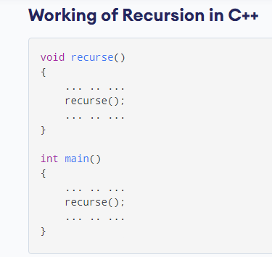
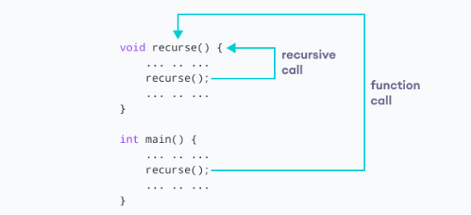
C++ Recursion
The recursion continues until some condition is met.
To prevent infinite recursion, if...else statement (or similar approach) can be used where one branch makes the recursive call and the other doesn't.

Slide 31
Example of Recursion:
int sum(int k)
{
if (k > 0)
{
return k + sum(k - 1);
}
else
{
return 0;
}
}
int main()
{
int result = sum(10);
cout << result;
return 0;
}

Slide 32
